Slide 1
Related Rates

Slide 2

Imagine that a stone is thrown into a still pond, creating a ripple.
Imagine that the radius of the ripple increases at the rate of 1 metre per second.
After 1 second, the circular ripple would have an area of $π{(1)}^{2}=πm^{2}$

Slide 3

Imagine that a stone is thrown into a still pond, creating a ripple.
Imagine that the radius of the ripple increases at the rate of 1 metre per second.
After 1 second, the circular ripple would have an area of $π{(1)}^{2}=πm^{2}$
After 2 seconds, the circular ripple would have an area of $π{(2)}^{2}=4πm^{2}$ (an increase of $3πm^{2}$)

Slide 4
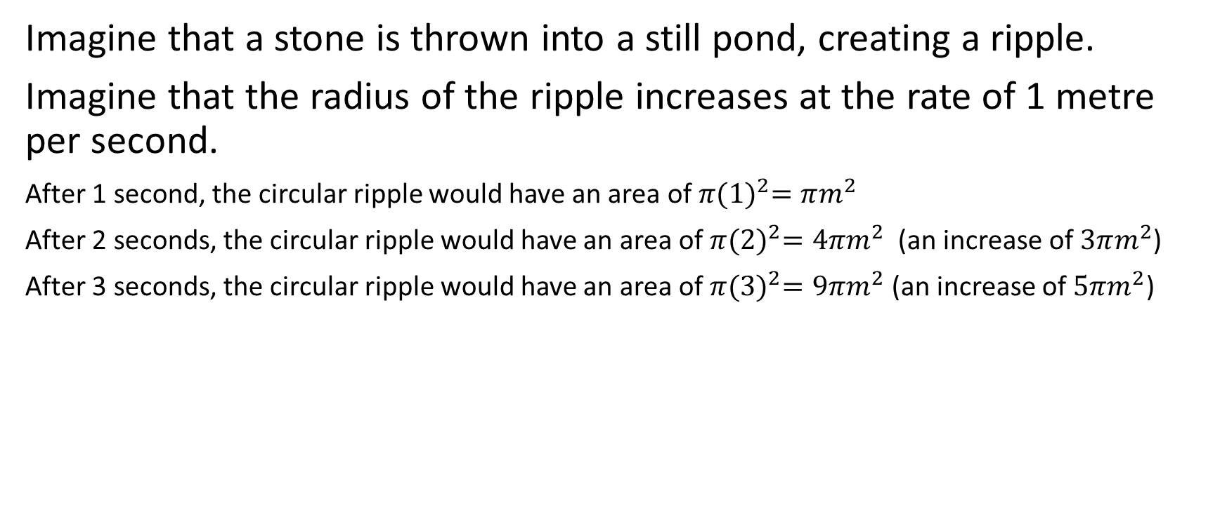
Imagine that a stone is thrown into a still pond, creating a ripple.
Imagine that the radius of the ripple increases at the rate of 1 metre per second.
After 1 second, the circular ripple would have an area of $π{(1)}^{2}=πm^{2}$
After 2 seconds, the circular ripple would have an area of $π{(2)}^{2}=4πm^{2}$ (an increase of $3πm^{2}$)
After 3 seconds, the circular ripple would have an area of $π{(3)}^{2}=9πm^{2}$ (an increase of $5πm^{2}$)

Slide 5
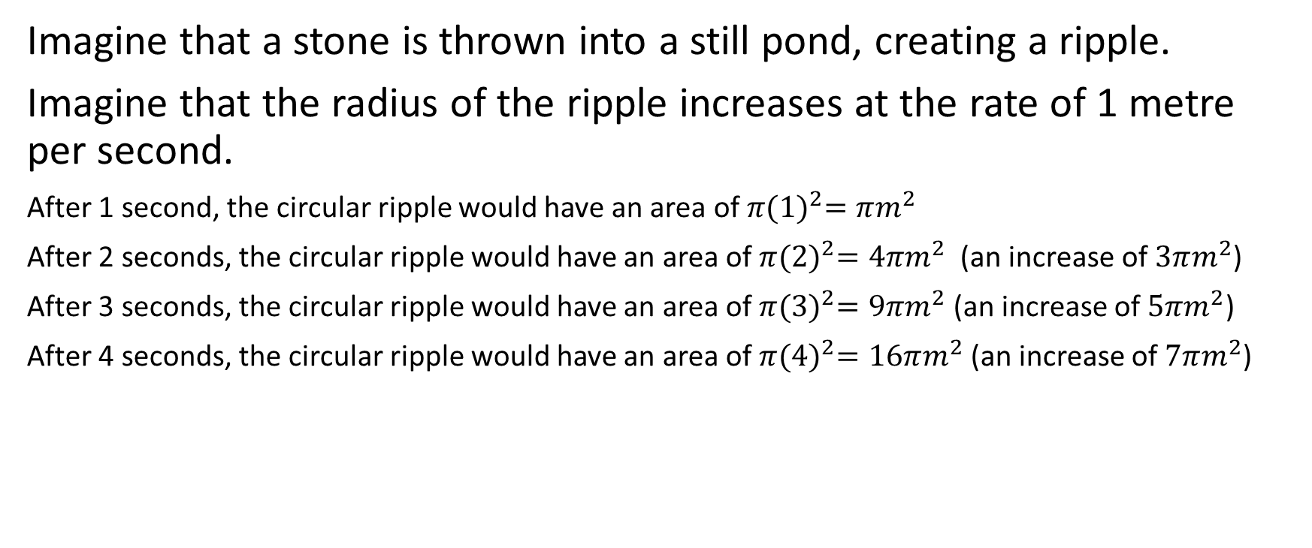
Imagine that a stone is thrown into a still pond, creating a ripple.
Imagine that the radius of the ripple increases at the rate of 1 metre per second.
After 1 second, the circular ripple would have an area of $π{(1)}^{2}=πm^{2}$
After 2 seconds, the circular ripple would have an area of $π{(2)}^{2}=4πm^{2}$ (an increase of $3πm^{2}$)
After 3 seconds, the circular ripple would have an area of $π{(3)}^{2}=9πm^{2}$ (an increase of $5πm^{2}$)
After 4 seconds, the circular ripple would have an area of $π{(4)}^{2}=16πm^{2}$ (an increase of $7πm^{2}$)

Slide 6
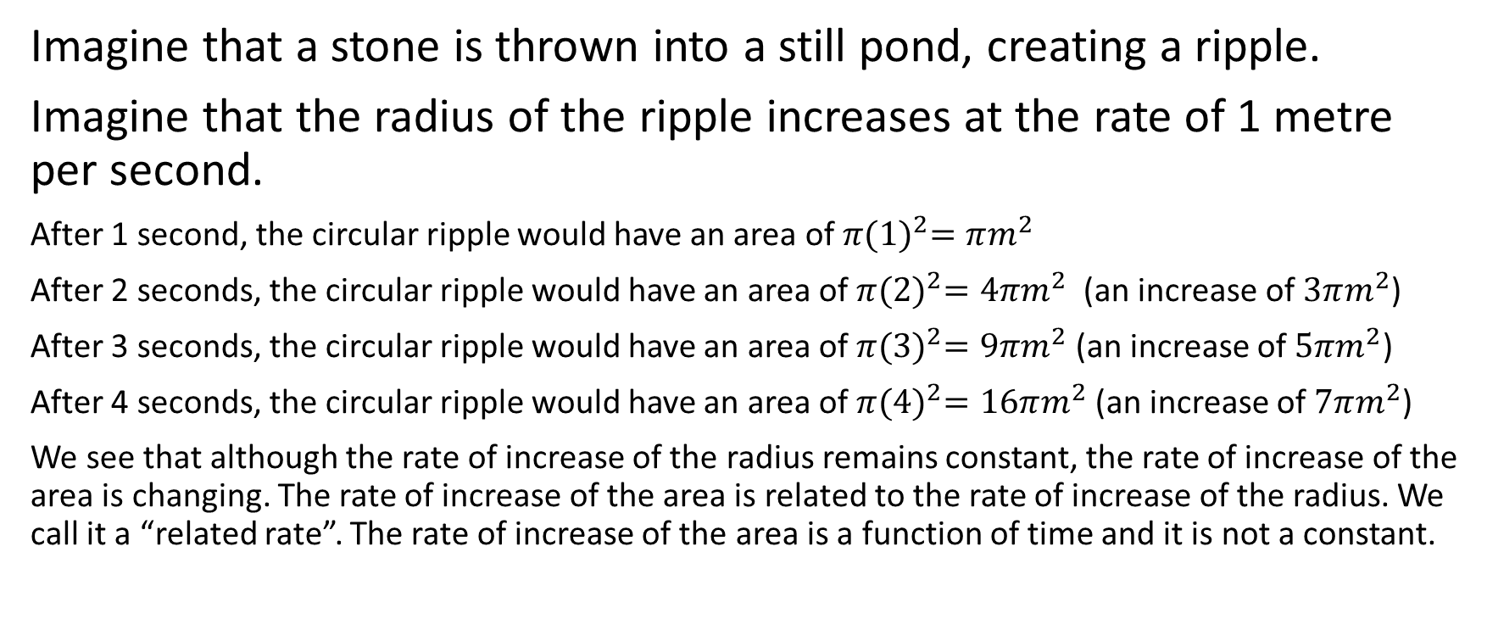
Imagine that a stone is thrown into a still pond, creating a ripple.
Imagine that the radius of the ripple increases at the rate of 1 metre per second.
After 1 second, the circular ripple would have an area of $π{(1)}^{2}=πm^{2}$
After 2 seconds, the circular ripple would have an area of $π{(2)}^{2}=4πm^{2}$ (an increase of $3πm^{2}$)
After 3 seconds, the circular ripple would have an area of $π{(3)}^{2}=9πm^{2}$ (an increase of $5πm^{2}$)
After 4 seconds, the circular ripple would have an area of $π{(4)}^{2}=16πm^{2}$ (an increase of $7πm^{2}$)
We see that although the rate of increase of the radius remains constant, the rate of increase of the area is changing. The rate of increase of the area is related to the rate of increase of the radius. We call it a “related rate”. The rate of increase of the area is a function of time and it is not a constant.

Slide 7
There are many types of related rates in Calculus. For example,
Imagine a stone in a pond causing a circular ripple. The rate of increase of the area of the circular ripple will be related to the rate of increase of the radius of the ripple. If the rate of increase of the radius of the circular ripple is constant, the rate of increase of the area of the circular ripple will not be.
Imagine blowing air into a spherical balloon. The rate of increase of the radius of the sphere will be related to the rate of increase of the volume of the sphere. If the rate of increase of the volume of air in the sphere is constant, the rate of increase of the radius of the sphere will not be.
Imagine filling a cone shaped container with liquid. The rate of increase of the height of the liquid will be related to the rate of increase of the volume of the liquid in the cone. If the rate of increase of the volume of the liquid is constant, the rate of increase of the height of the liquid will not be.
There are many more examples.

Slide 8
How do we approach a related rates problem?
Some people like to draw a diagram.
Assign a variable to each quantity in the problem that is a function of the independent variable. (We’ll assume for the remainder of this discussion that the independent variable is time)
Develop an equation that associates the variables with one another.
Differentiate (possibly using implicit differentiation).
Substitute in given information and solve for the required rate of change.

Slide 9

Example
When a raindrop falls into a small puddle, it creates a circular ripple that spreads out from the point where the raindrop hit. The radius of the circle grows at a rate of 3 cm/s.
determine the rate of increase of the circumference of the circle with respect to time
determine the rate of increase of the area of the circle when its area is $81π{cm}^{2}$.

Slide 10
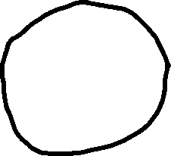
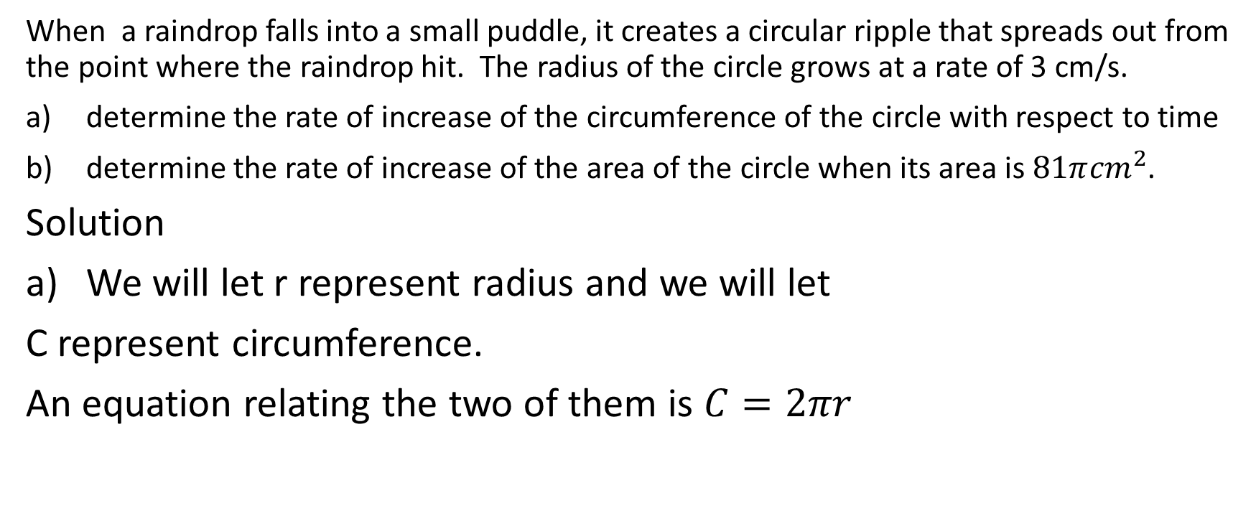

When a raindrop falls into a small puddle, it creates a circular ripple that spreads out from the point where the raindrop hit. The radius of the circle grows at a rate of 3 cm/s.
determine the rate of increase of the circumference of the circle with respect to time
determine the rate of increase of the area of the circle when its area is $81π{cm}^{2}$.
Solution
We will let r represent radius and we will let
C represent circumference.
An equation relating the two of them is $C=2πr$

Slide 11
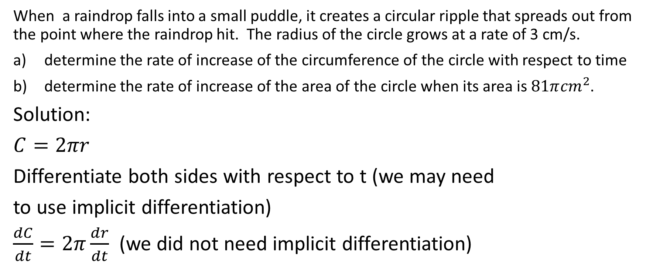
When a raindrop falls into a small puddle, it creates a circular ripple that spreads out from the point where the raindrop hit. The radius of the circle grows at a rate of 3 cm/s.
determine the rate of increase of the circumference of the circle with respect to time
determine the rate of increase of the area of the circle when its area is $81π{cm}^{2}$.
Solution:
$C=2πr$
Differentiate both sides with respect to t (we may need
to use implicit differentiation)
$\frac{dC}{dt}=2π\frac{dr}{dt}$ (we did not need implicit differentiation)

Slide 12

Aside: Sometimes people are not sure how we differentiated both sides of this expression. If you understand that, then you can ignore this slide.
On the left side, the derivative of C with respect to t is plainly $\frac{dC}{dt}$
On the right side, we can use a product rule if we want to. Think of the right side as the function $2π$ times the function r. Now, let’s use the product rule. $2π$ is a constant, so the derivative of $2π$ with respect to r is 0. Then, we multiply by r. Then we add $2π$ times the derivative of r with respect to t. This product is just $2π\frac{dr}{dt}$. In other words, the derivative of the right hand side is $0\left(r\right)+2π\frac{dr}{dt}=2π\frac{dr}{dt}$. Now, let’s go back to the solution $→$

Slide 13
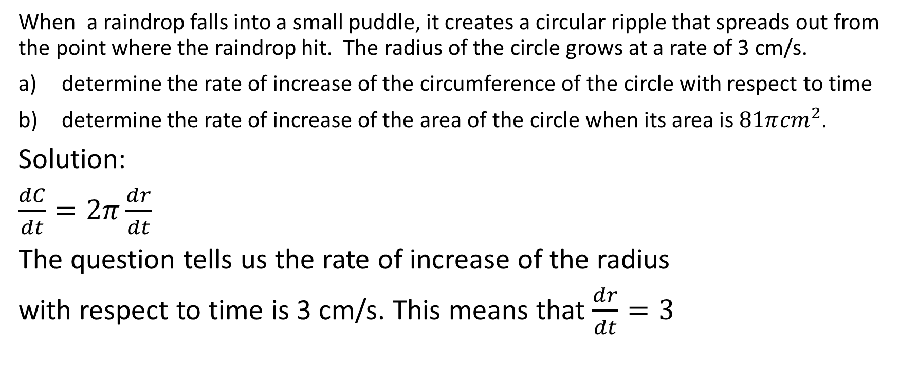
When a raindrop falls into a small puddle, it creates a circular ripple that spreads out from the point where the raindrop hit. The radius of the circle grows at a rate of 3 cm/s.
determine the rate of increase of the circumference of the circle with respect to time
determine the rate of increase of the area of the circle when its area is $81π{cm}^{2}$.
Solution:
$\frac{dC}{dt}=2π\frac{dr}{dt}$
The question tells us the rate of increase of the radius
with respect to time is 3 cm/s. This means that $\frac{dr}{dt}=3$

Slide 14
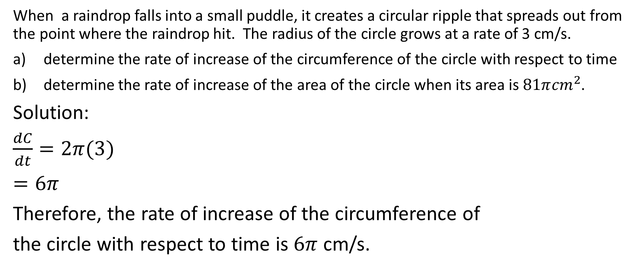
When a raindrop falls into a small puddle, it creates a circular ripple that spreads out from the point where the raindrop hit. The radius of the circle grows at a rate of 3 cm/s.
determine the rate of increase of the circumference of the circle with respect to time
determine the rate of increase of the area of the circle when its area is $81π{cm}^{2}$.
Solution:
$\frac{dC}{dt}=2π(3)$
$=6π$
Therefore, the rate of increase of the circumference of
the circle with respect to time is $6π$ cm/s.

Slide 15
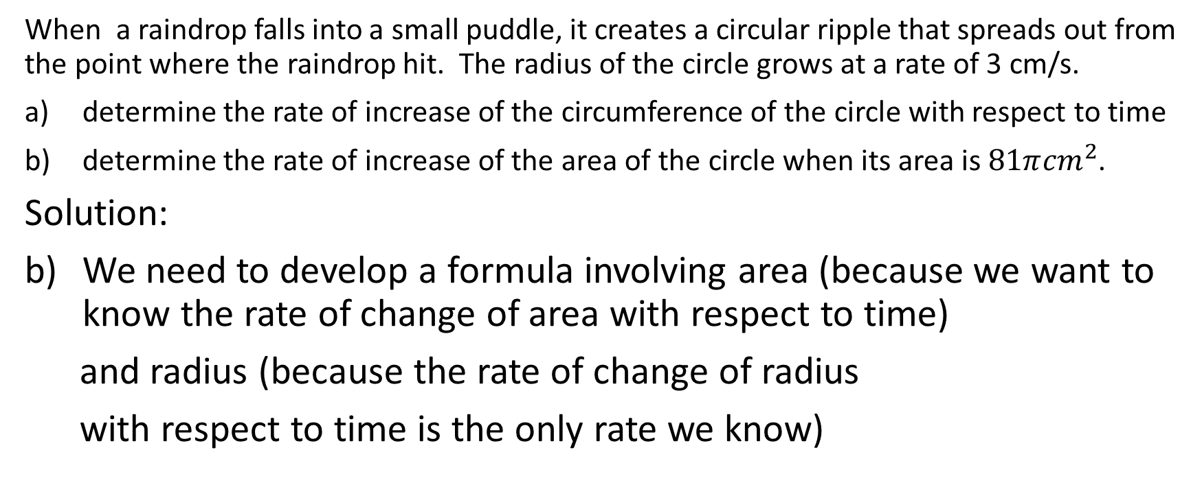
When a raindrop falls into a small puddle, it creates a circular ripple that spreads out from the point where the raindrop hit. The radius of the circle grows at a rate of 3 cm/s.
determine the rate of increase of the circumference of the circle with respect to time
determine the rate of increase of the area of the circle when its area is $81π{cm}^{2}$.
Solution:
We need to develop a formula involving area (because we want to know the rate of change of area with respect to time)
and radius (because the rate of change of radius
with respect to time is the only rate we know)

Slide 16
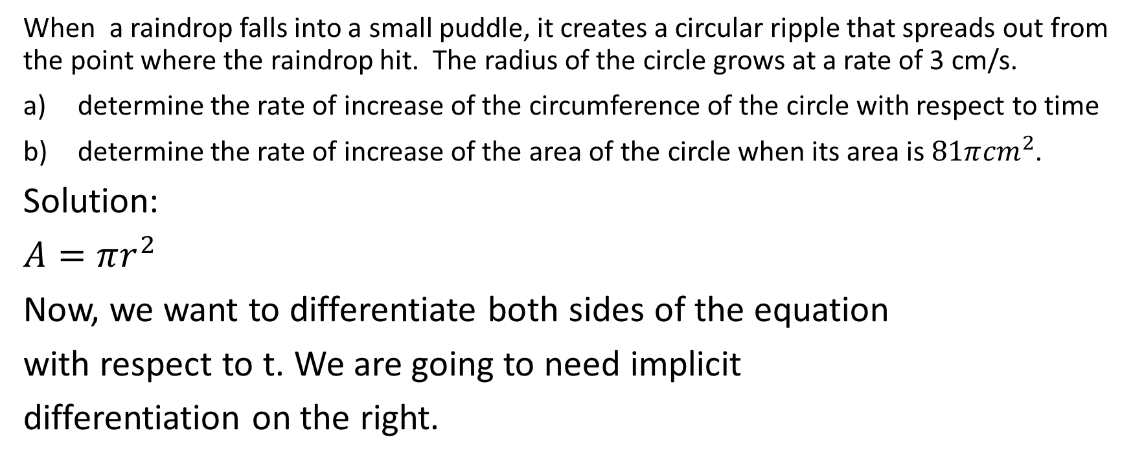
When a raindrop falls into a small puddle, it creates a circular ripple that spreads out from the point where the raindrop hit. The radius of the circle grows at a rate of 3 cm/s.
determine the rate of increase of the circumference of the circle with respect to time
determine the rate of increase of the area of the circle when its area is $81π{cm}^{2}$.
Solution:
$A=πr^{2}$
Now, we want to differentiate both sides of the equation
with respect to t. We are going to need implicit
differentiation on the right.

Slide 17
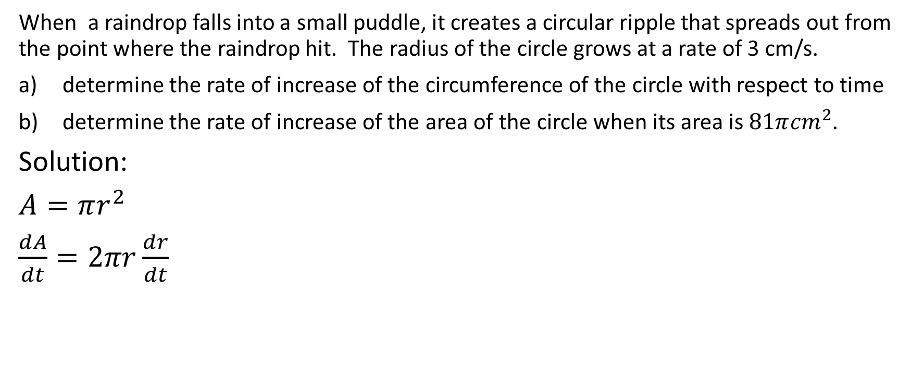
When a raindrop falls into a small puddle, it creates a circular ripple that spreads out from the point where the raindrop hit. The radius of the circle grows at a rate of 3 cm/s.
determine the rate of increase of the circumference of the circle with respect to time
determine the rate of increase of the area of the circle when its area is $81π{cm}^{2}$.
Solution:
$A=πr^{2}$
$\frac{dA}{dt}=2πr\frac{dr}{dt}$

Slide 18

Aside: Sometimes people don’t understand quite how we got the result that we got in the last line. If you understand it, then you can skip this slide.
We start with $A=πr^{2}$. We want to differentiate the left hand side with respect to t. The derivative of A with respect to t is plainly $\frac{dA}{dt}$.
Then, we want to differentiate the right hand side with respect to t. We can think of it as a product rule if we wish. The first function is $π$ and the second function is $r^{2}$. $π$ is simply a scalar, so the derivative of $π$ with respect to t is 0. So multiplying the derivative of the first function times the second function gives us $(0)r^{2}$. Then, we multiply the first function times the derivative of the second function. The first function is $π$ and the second function is $r^{2}$. We might be tempted to say that the derivative of $r^{2}$ is $2r$, but that’s incorrect. Remember that we are differentiating with respect to t. (recall in the implicit differentiation unit when we learned that the derivative of $y^{2}$ with respect to $x$ is $2y\frac{dy}{dx}$) Therefore, the derivative of $r^{2}$ with respect to t is $2r\frac{dr}{dt}$
Putting this all together, the derivative of the right side is $\left(0\right)\left(r^{2}\right)+\left(π\right)\left(2r\frac{dr}{dt}\right)=2π\frac{dr}{dt}$.
Now, back to the solution $→$

Slide 19
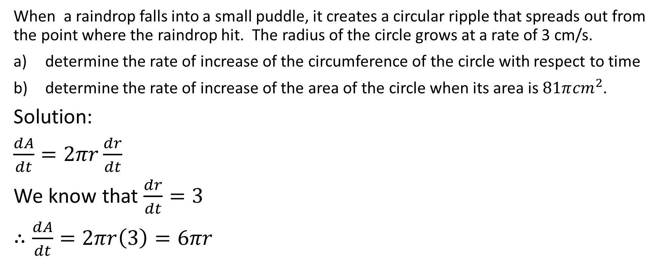
When a raindrop falls into a small puddle, it creates a circular ripple that spreads out from the point where the raindrop hit. The radius of the circle grows at a rate of 3 cm/s.
determine the rate of increase of the circumference of the circle with respect to time
determine the rate of increase of the area of the circle when its area is $81π{cm}^{2}$.
Solution:
$\frac{dA}{dt}=2πr\frac{dr}{dt}$
We know that $\frac{dr}{dt}=3$
$∴\frac{dA}{dt}=2πr\left(3\right)=6πr$

Slide 20
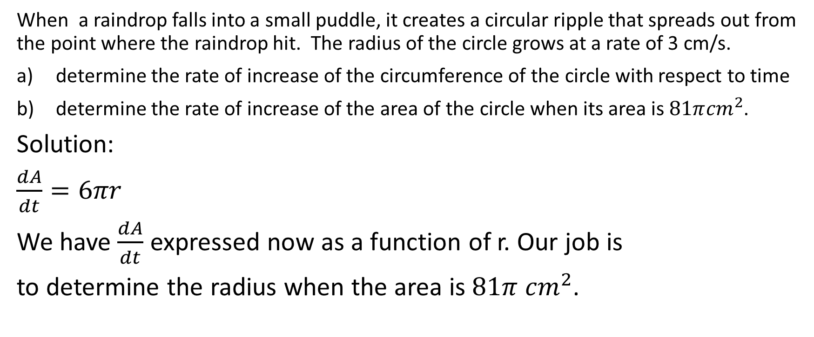
When a raindrop falls into a small puddle, it creates a circular ripple that spreads out from the point where the raindrop hit. The radius of the circle grows at a rate of 3 cm/s.
determine the rate of increase of the circumference of the circle with respect to time
determine the rate of increase of the area of the circle when its area is $81π{cm}^{2}$.
Solution:
$\frac{dA}{dt}=6πr$
We have $\frac{dA}{dt}$ expressed now as a function of r. Our job is
to determine the radius when the area is $81π {cm}^{2}$.

Slide 21
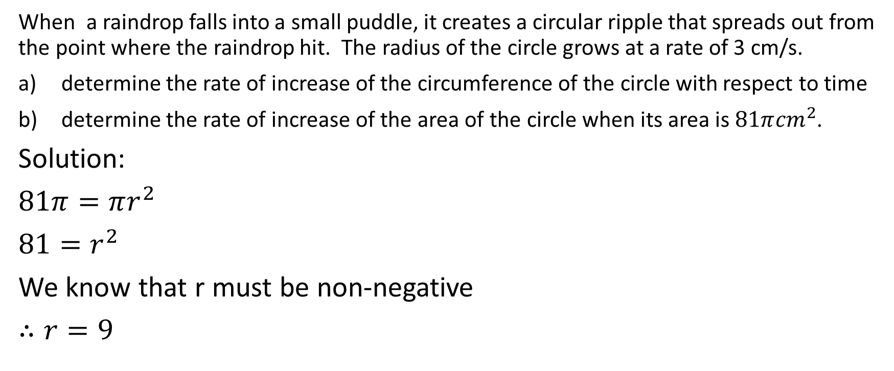
When a raindrop falls into a small puddle, it creates a circular ripple that spreads out from the point where the raindrop hit. The radius of the circle grows at a rate of 3 cm/s.
determine the rate of increase of the circumference of the circle with respect to time
determine the rate of increase of the area of the circle when its area is $81π{cm}^{2}$.
Solution:
$81π=πr^{2}$
$81=r^{2}$
We know that r must be non-negative
$∴r=9$

Slide 22
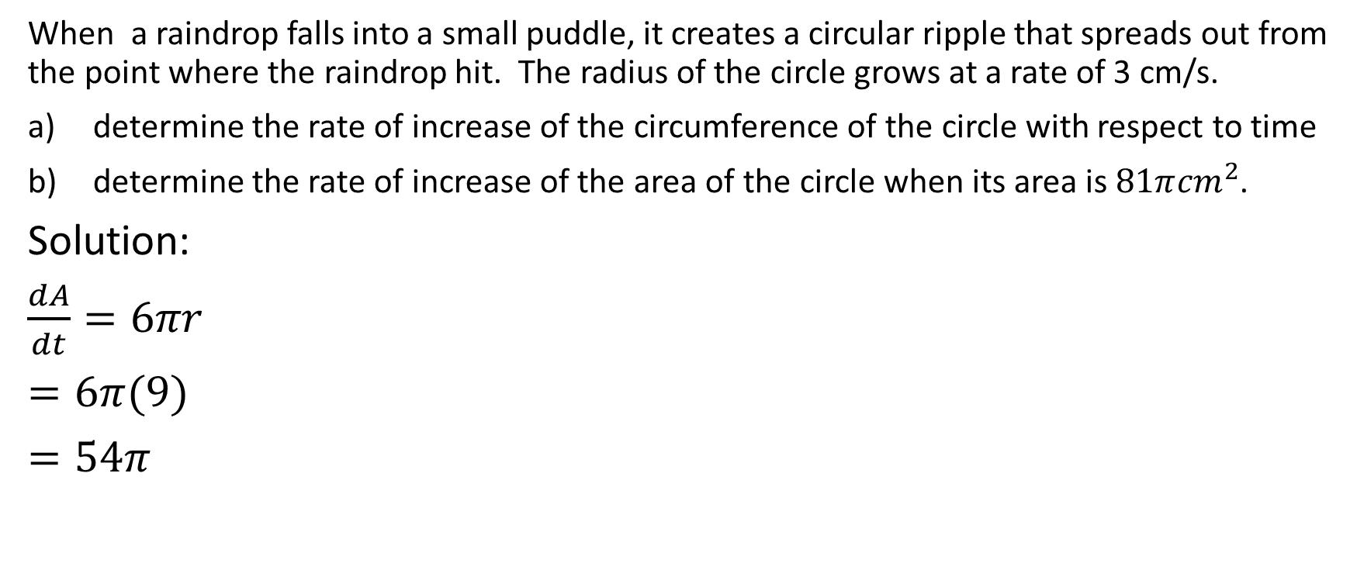
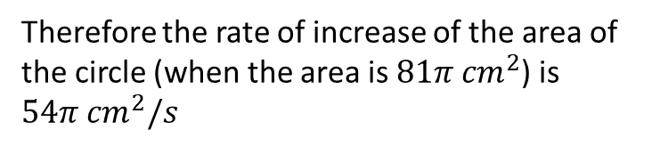
When a raindrop falls into a small puddle, it creates a circular ripple that spreads out from the point where the raindrop hit. The radius of the circle grows at a rate of 3 cm/s.
determine the rate of increase of the circumference of the circle with respect to time
determine the rate of increase of the area of the circle when its area is $81π{cm}^{2}$.
Solution:
$\frac{dA}{dt}=6πr$
$=6π(9)$
$=54π$
Therefore the rate of increase of the area of the circle (when the area is $81π {cm}^{2}$) is $54π {cm}^{2}/s$

Slide 23

Example
Water is pouring into an inverted right circular cone at a rate of $π$ m³/min. The height and the diameter of the base of the cone are both 10 m. How fast is the water level rising when the depth of the water is 8m?

Slide 24

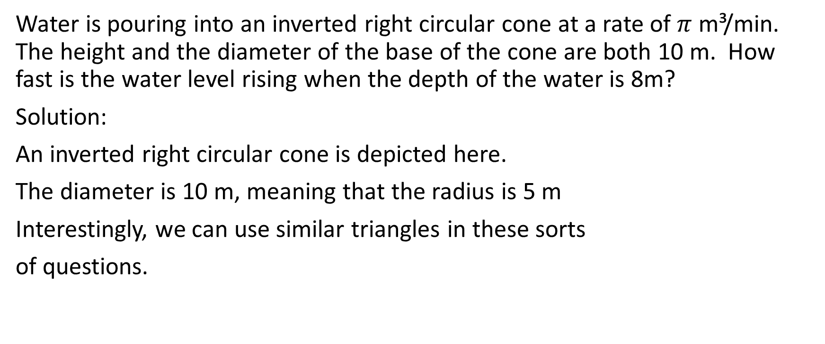


Water is pouring into an inverted right circular cone at a rate of $π$ m³/min. The height and the diameter of the base of the cone are both 10 m. How fast is the water level rising when the depth of the water is 8m?
Solution:
An inverted right circular cone is depicted here.
The diameter is 10 m, meaning that the radius is 5 m
Interestingly, we can use similar triangles in these sorts
of questions.

Slide 25


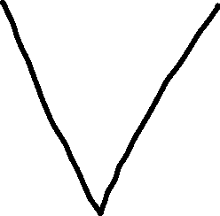


The red triangle …

Slide 26







The red triangle is similar to the green triangle …

Slide 27








The red triangle is similar to the green triangle
which is similar to the black triangle.

Slide 28
The red triangle is similar to the green triangle
which is similar to the black triangle.
In other words, the ratio of the height to the
radius is the same for each of the three triangles

Slide 29
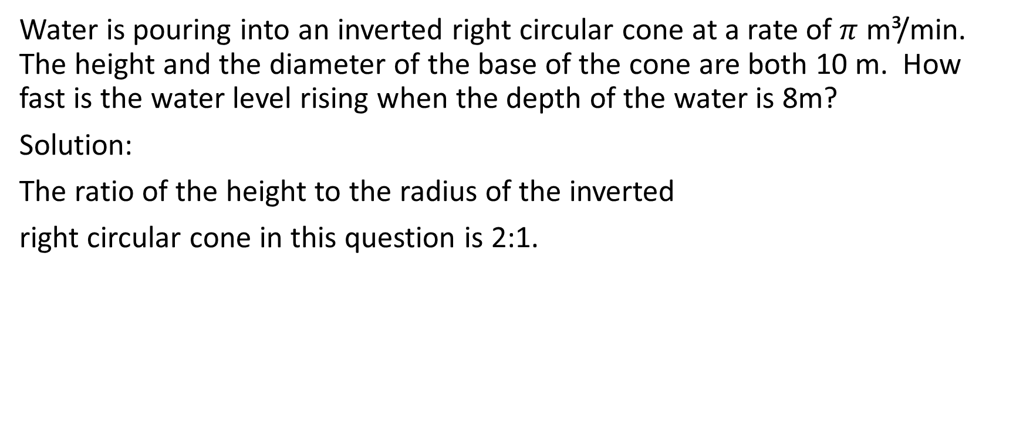
Water is pouring into an inverted right circular cone at a rate of $π$ m³/min. The height and the diameter of the base of the cone are both 10 m. How fast is the water level rising when the depth of the water is 8m?
Solution:
The ratio of the height to the radius of the inverted
right circular cone in this question is 2:1.

Slide 30
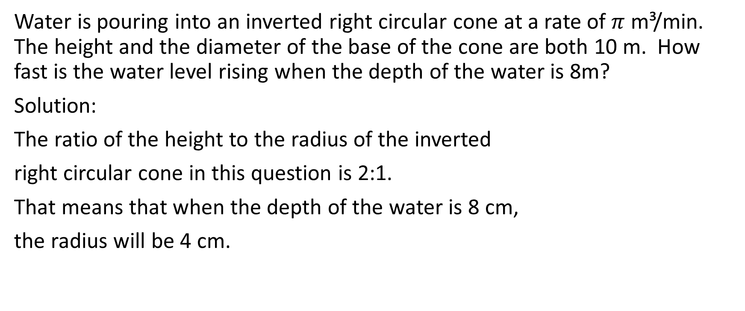

Water is pouring into an inverted right circular cone at a rate of $π$ m³/min. The height and the diameter of the base of the cone are both 10 m. How fast is the water level rising when the depth of the water is 8m?
Solution:
The ratio of the height to the radius of the inverted
right circular cone in this question is 2:1.
That means that when the depth of the water is 8 cm,
the radius will be 4 cm.

Slide 31
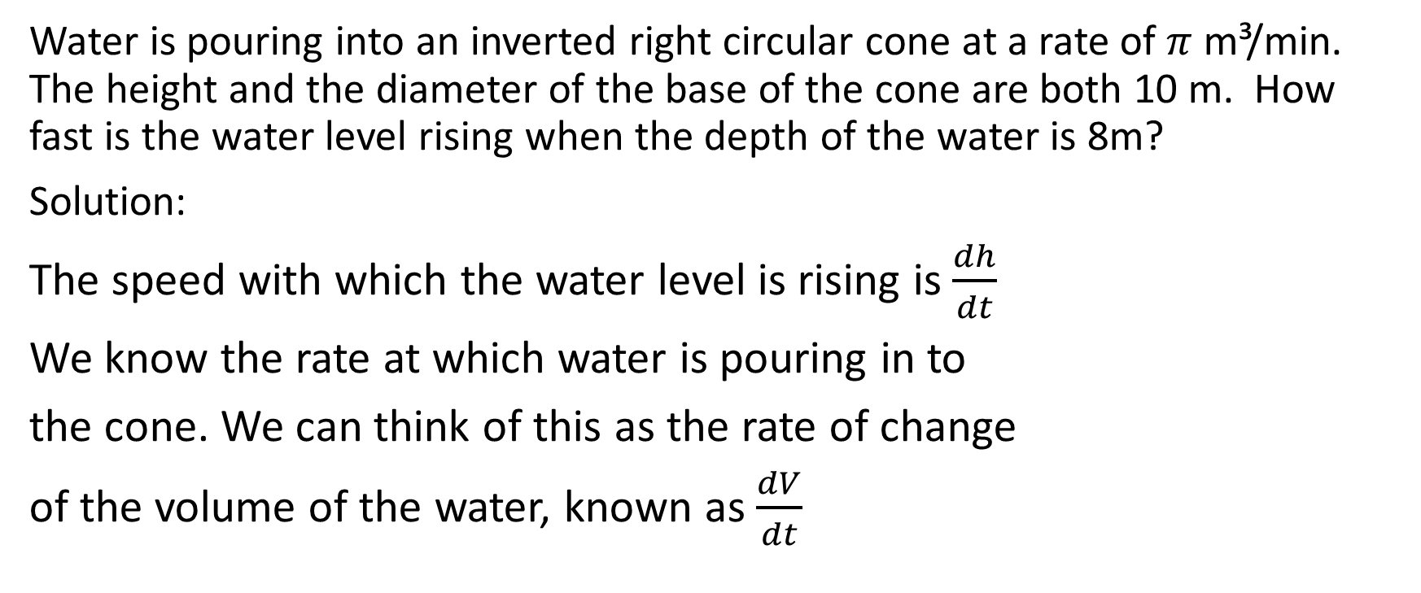
Water is pouring into an inverted right circular cone at a rate of $π$ m³/min. The height and the diameter of the base of the cone are both 10 m. How fast is the water level rising when the depth of the water is 8m?
Solution:
The speed with which the water level is rising is $\frac{dh}{dt}$
We know the rate at which water is pouring in to
the cone. We can think of this as the rate of change
of the volume of the water, known as $\frac{dV}{dt}$

Slide 32
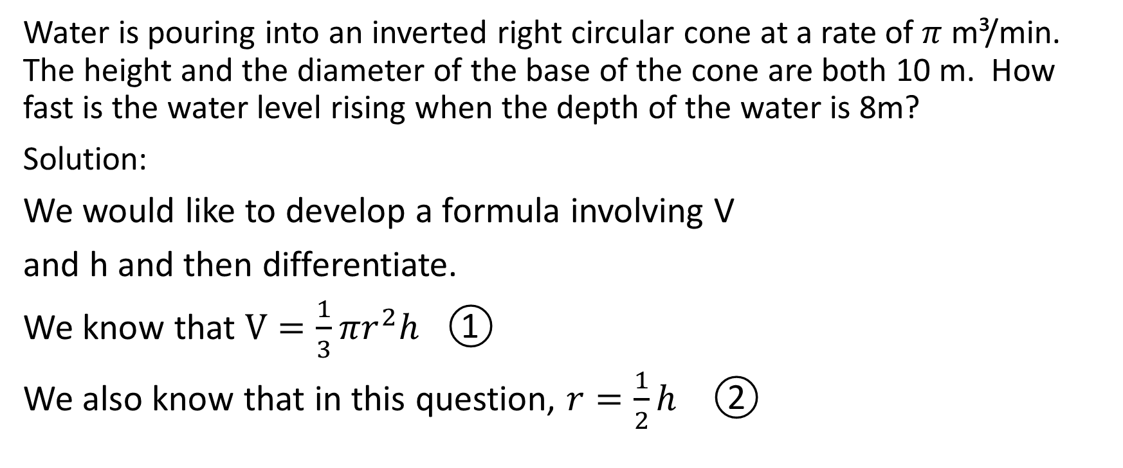
Water is pouring into an inverted right circular cone at a rate of $π$ m³/min. The height and the diameter of the base of the cone are both 10 m. How fast is the water level rising when the depth of the water is 8m?
Solution:
We would like to develop a formula involving V
and h and then differentiate.
We know that $V=\frac{1}{3}πr^{2}h$ ①
We also know that in this question, $r=\frac{1}{2}h$ ②

Slide 33
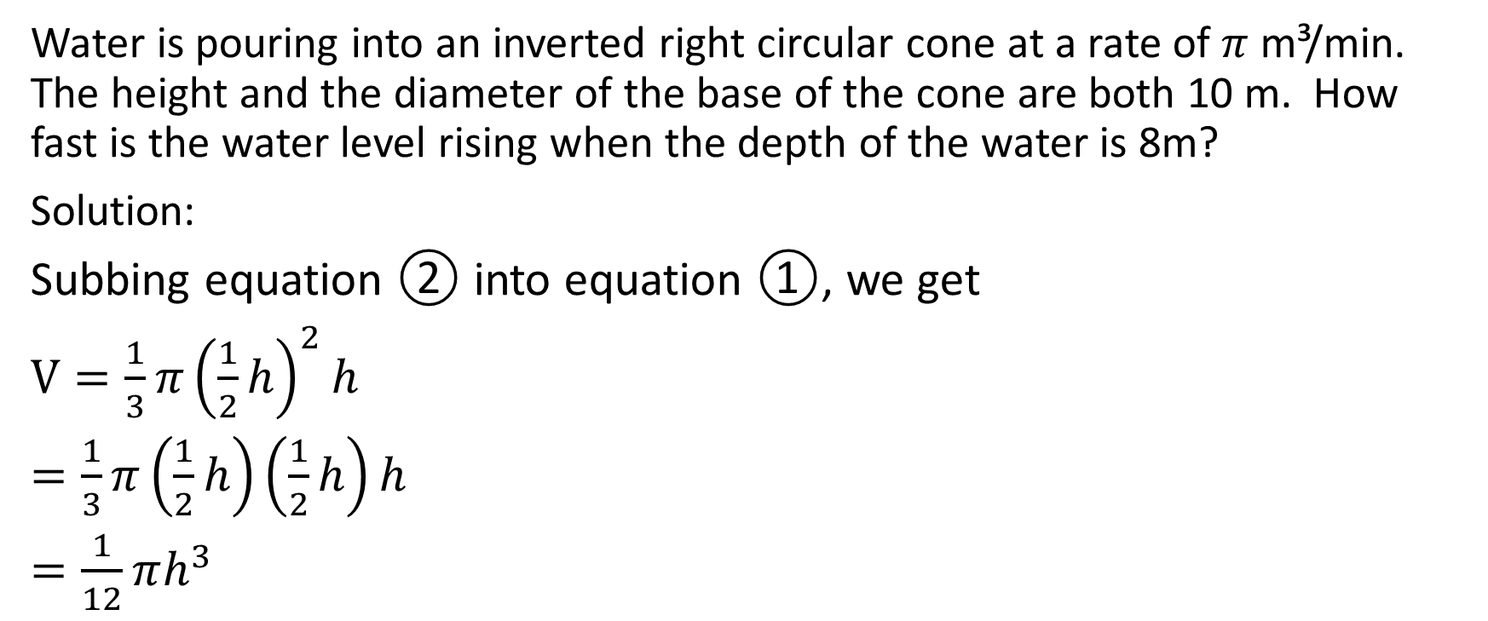
Water is pouring into an inverted right circular cone at a rate of $π$ m³/min. The height and the diameter of the base of the cone are both 10 m. How fast is the water level rising when the depth of the water is 8m?
Solution:
Subbing equation ② into equation ①, we get
$V=\frac{1}{3}π{\left(\frac{1}{2}h\right)}^{2}h$
$=\frac{1}{3}π\left(\frac{1}{2}h\right)\left(\frac{1}{2}h\right)h$
$=\frac{1}{12}πh^{3}$

Slide 34
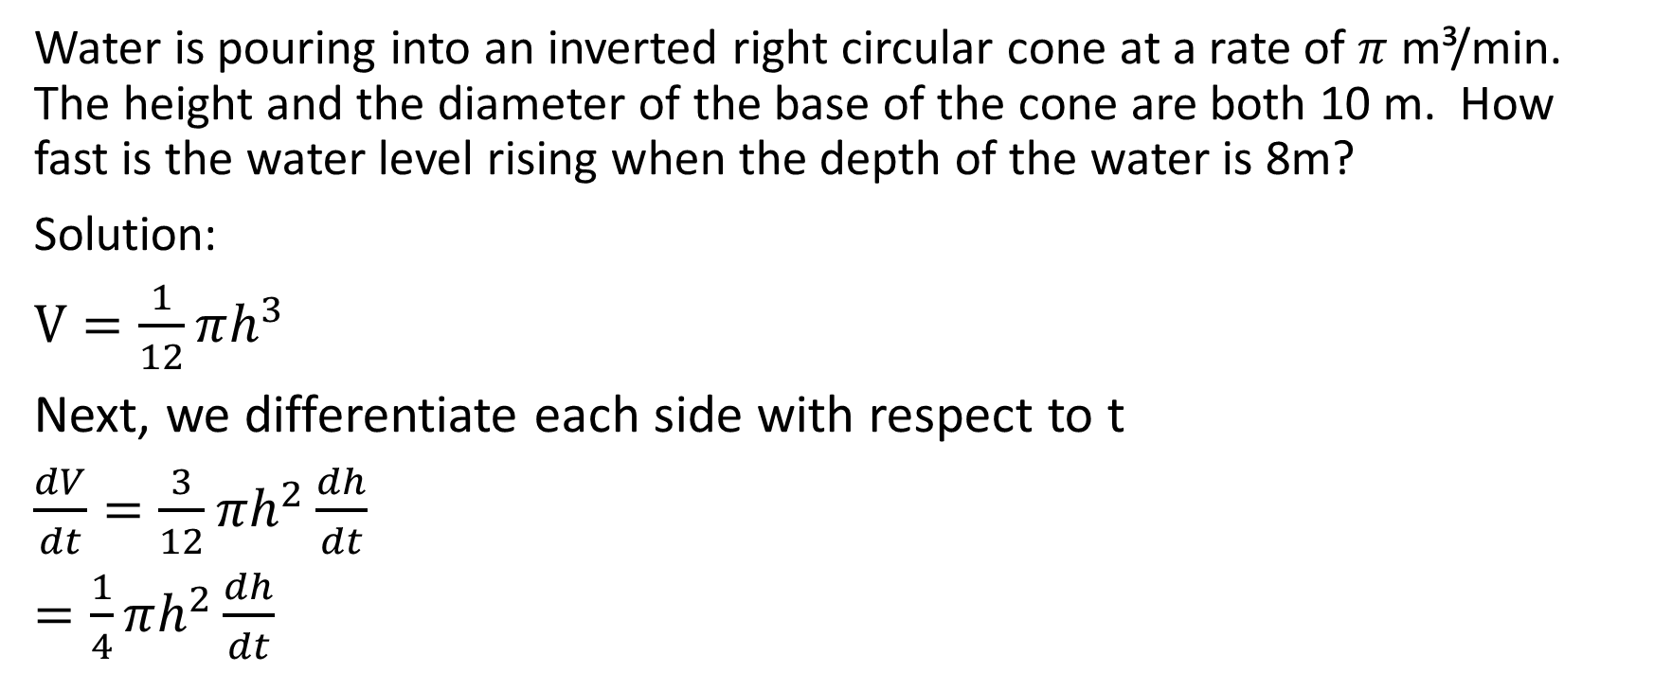
Water is pouring into an inverted right circular cone at a rate of $π$ m³/min. The height and the diameter of the base of the cone are both 10 m. How fast is the water level rising when the depth of the water is 8m?
Solution:
$V=\frac{1}{12}πh^{3}$
Next, we differentiate each side with respect to t
$\frac{dV}{dt}=\frac{3}{12}πh^{2}\frac{dh}{dt}$
$=\frac{1}{4}πh^{2}\frac{dh}{dt}$

Slide 35

Aside: Sometimes people don’t understand quite how we got the result that we got in the last line. If you understand it, then you can skip this slide.
We start with $V=\frac{1}{12}πh^{3}$. We want to differentiate the left hand side with respect to t. The derivative of A with respect to t is plainly $\frac{dV}{dt}$.
Then, we want to differentiate the right hand side with respect to t. We can think of it as a product rule if we wish. The first function is $\frac{1}{12}π$ and the second function is $h^{3}$. $\frac{1}{12}π$ is simply a scalar, so the derivative of $\frac{1}{12}π$ with respect to t is 0. So multiplying the derivative of the first function times the second function gives us $(0)h^{3}$. Then, we multiply the first function times the derivative of the second function. The first function is $\frac{1}{12}π$ and the second function is $h^{3}$. We might be tempted to say that the derivative of $h^{3}$ is $3h^{2}$, but that’s incorrect. Remember that we are differentiating with respect to t. (recall in the implicit differentiation unit when we learned that the derivative of $y^{3}$ with respect to $x$ is $3y^{2}\frac{dy}{dx}$) Therefore, the derivative of $h^{3}$ with respect to t is $3h^{2}\frac{dh}{dt}$
Putting this all together, the derivative of the right side is $\left(0\right)\left(h^{3}\right)+\left(\frac{1}{12}π\right)\left(3h^{2}\frac{dh}{dt}\right)=\frac{3}{12}πh^{2}\frac{dh}{dt}=\frac{1}{4}πh^{2}\frac{dh}{dt}$.
Now, back to the solution $→$

Slide 36
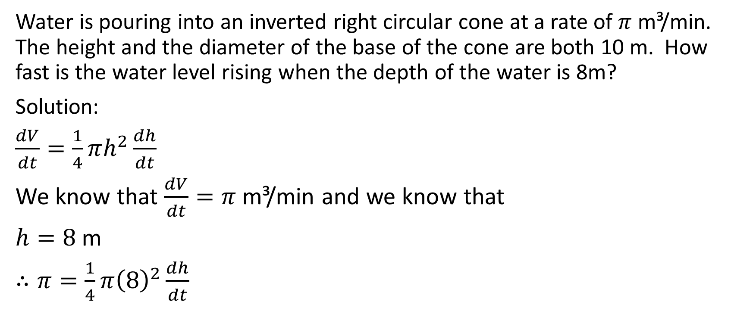
Water is pouring into an inverted right circular cone at a rate of $π$ m³/min. The height and the diameter of the base of the cone are both 10 m. How fast is the water level rising when the depth of the water is 8m?
Solution:
$\frac{dV}{dt}=\frac{1}{4}πh^{2}\frac{dh}{dt}$
We know that $\frac{dV}{dt}=π$ m³/min and we know that
$h=8$ m
$∴π=\frac{1}{4}π{\left(8\right)}^{2}\frac{dh}{dt}$

Slide 37
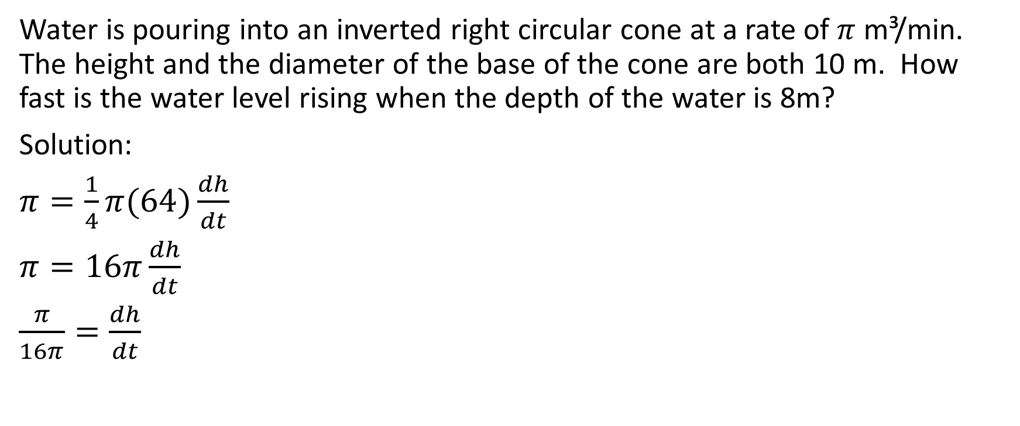
Water is pouring into an inverted right circular cone at a rate of $π$ m³/min. The height and the diameter of the base of the cone are both 10 m. How fast is the water level rising when the depth of the water is 8m?
Solution:
$π=\frac{1}{4}π(64)\frac{dh}{dt}$
$π=16π\frac{dh}{dt}$
$\frac{π}{16π}=\frac{dh}{dt}$

Slide 38
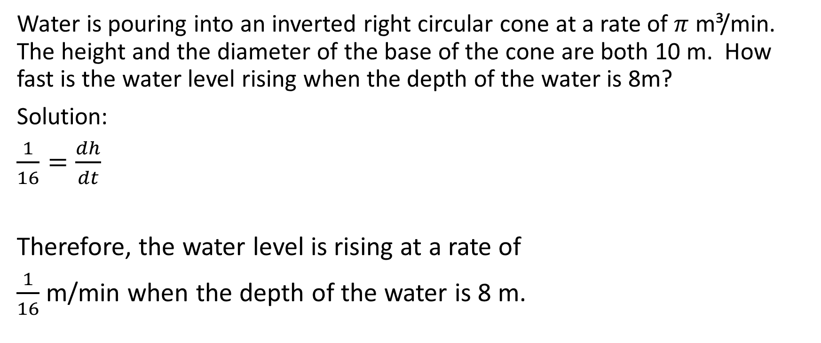
Water is pouring into an inverted right circular cone at a rate of $π$ m³/min. The height and the diameter of the base of the cone are both 10 m. How fast is the water level rising when the depth of the water is 8m?
Solution:
$\frac{1}{16}=\frac{dh}{dt}$
Therefore, the water level is rising at a rate of
$\frac{1}{16}$ m/min when the depth of the water is 8 m.

